Slide 1
Topics
CAR Owner Resources
Assign Owner’s Assistant
Attaching Documents
CAR Database

Slide 2
CAR Owner Resources

Slide 3
CAR Owner Resources
CAR Administrator (CAR Champion)
Champions the CAR
Primary point of assistance for CAR Owner
CAR ownership questions
CAR validity concerns
Root Cause Analysis guidance
Corrective Action Plan assistance
Reviews Extension Requests
Either approves CAR Owner responses or requests additional information

Slide 4
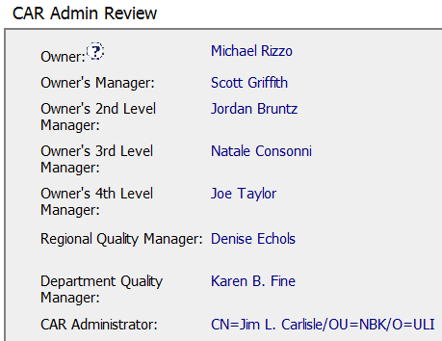
CAR Owner Resources, cont.
CAR Administrator (CAR Champion)

Slide 5
CAR Owner Resources, cont.
CAR Process SOP 00-QA-S0006
CAR Website
Supplements the CAR Process SOP
Frequently Asked Questions
Link to CAR Database

Slide 6
Assign Owner’s Assistant

Slide 7
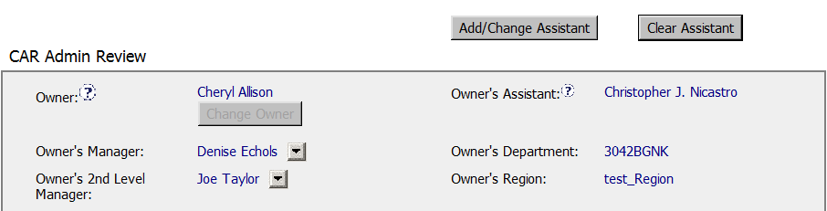
Assign Owner’s Assistant
To Assign/Remove an Owner’s Assistant:
Remove
Owner’s
Assistant
Add
Owner’s
Assistant

Slide 8
Attaching Documents

Slide 9
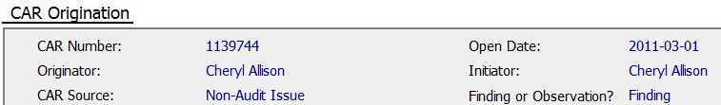

Attaching Documents
Attach documents that support the analysis in the “Attachments/Comments” area of the CAR.
Remember: Milestone related information is attached within the milestone
.
.
.

Slide 10
CAR Database

Slide 11
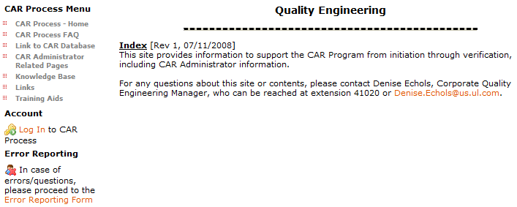
CAR Database
Access the CAR Database via the CAR Process Website

Slide 12
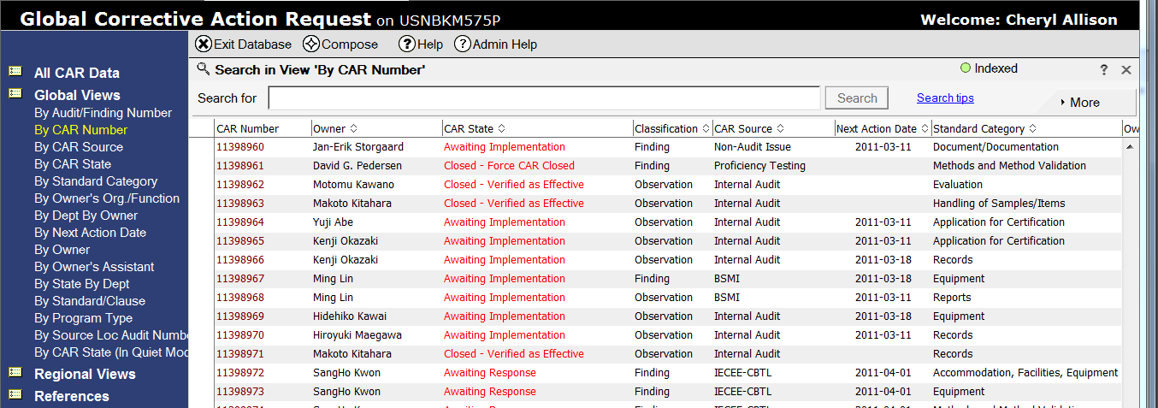
CAR Database, cont.
View: By CAR Number

Slide 13
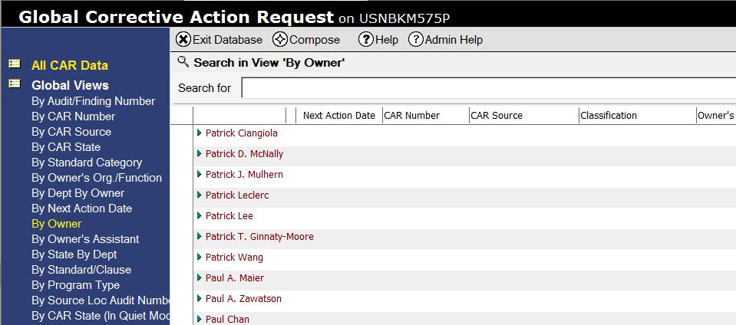
CAR Database, cont.
View: By CAR Owner

